Slide 1
I am Thankful Presentation

Slide 2
I’m thankful to have a safe, warm home.

Slide 3
I’m thankful to have a choice of clothes to wear, and access to a washing machine.

Slide 4
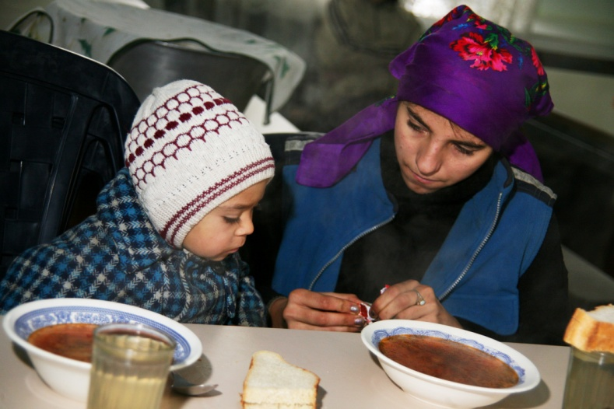
I’m thankful that I have enough food to eat – every day

Slide 5
I am thankful for indoor plumbing…

Slide 6
… and for an indoor toilet!

Slide 7
I am thankful that I have electricity, and that it is safe.

Slide 8
I am grateful that I have transport,
and can travel easily and comfortably

Slide 9
I am thankful that I have a warm bed
to sleep in at night time

Slide 10
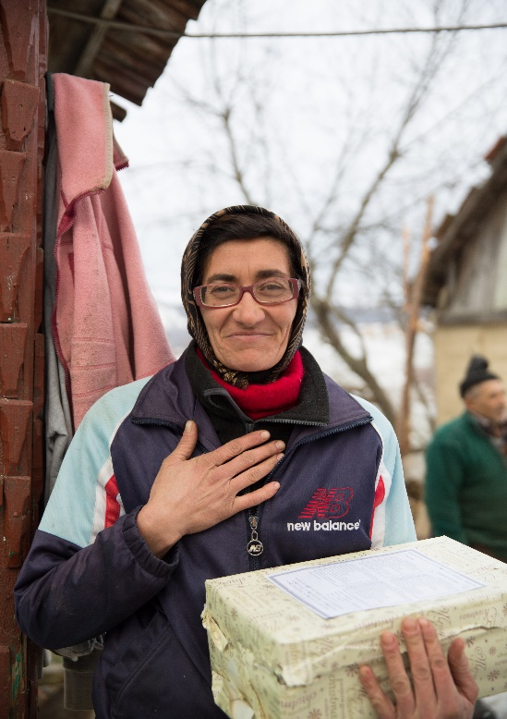
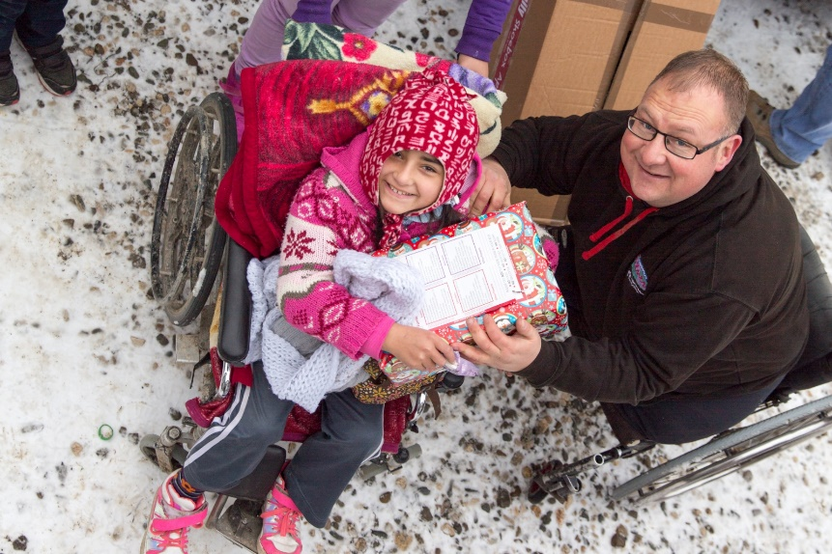
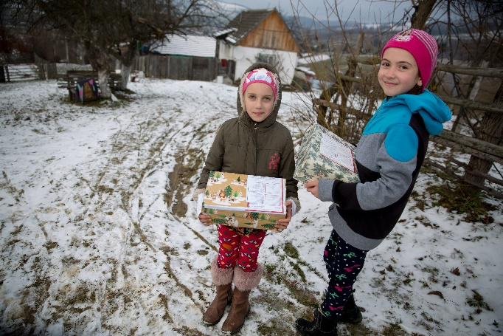
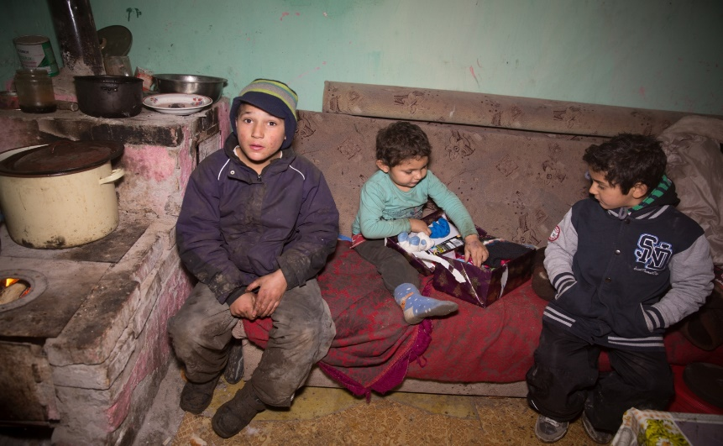
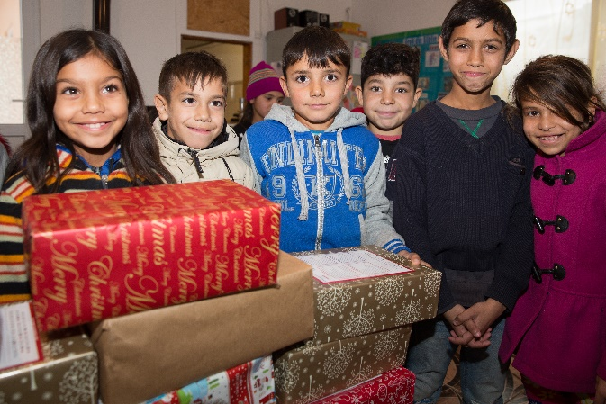
I’m thankful that by making a shoebox I can make a difference

