Slide 1
Bags of Wool Presentation

Slide 2
Large families live in small, single roomed houses

Slide 3
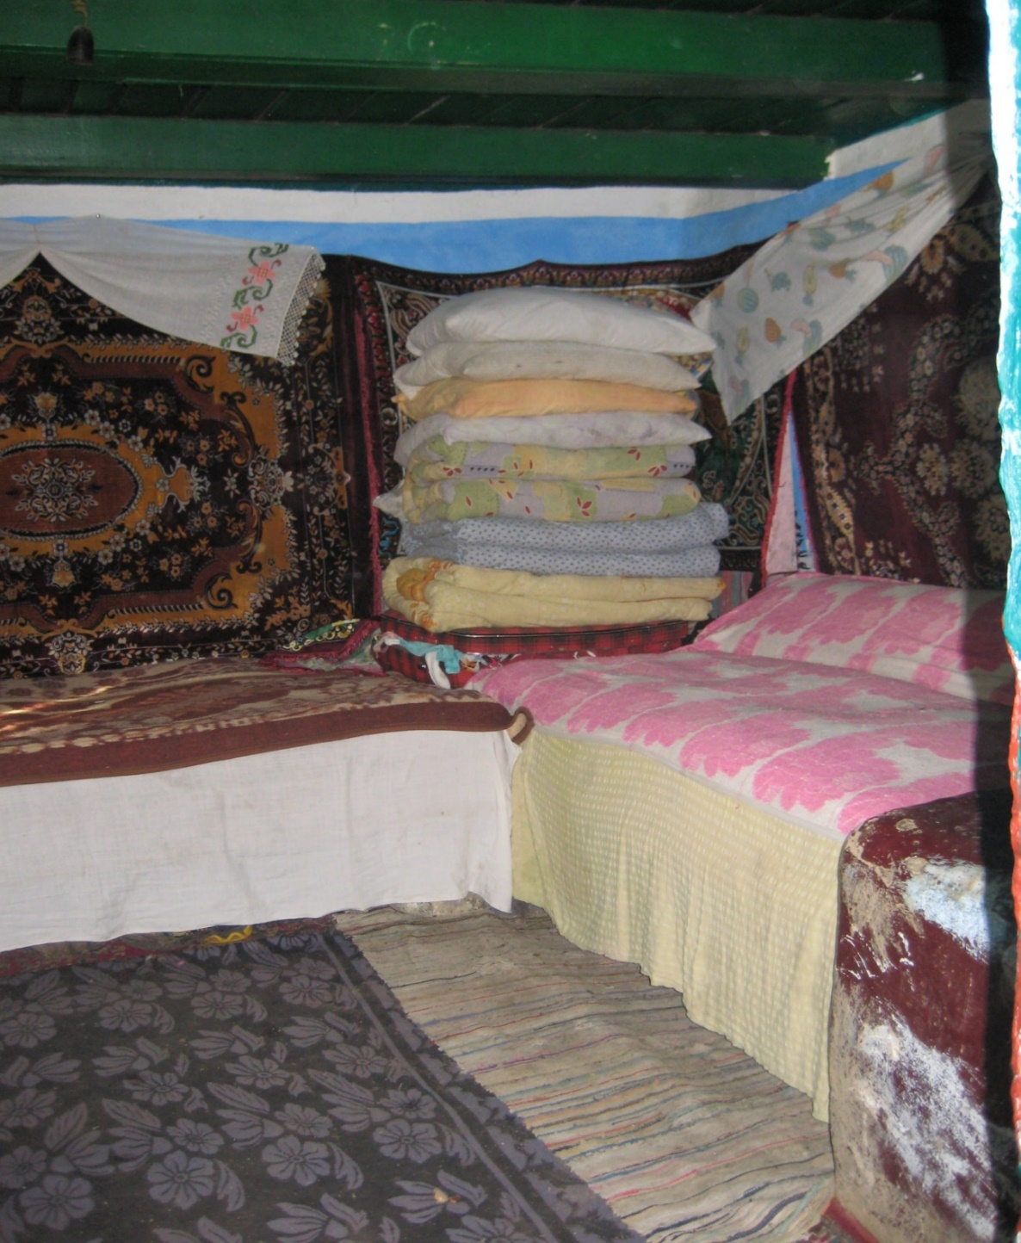
Families sleep together in one room and have to share beds.

Slide 4
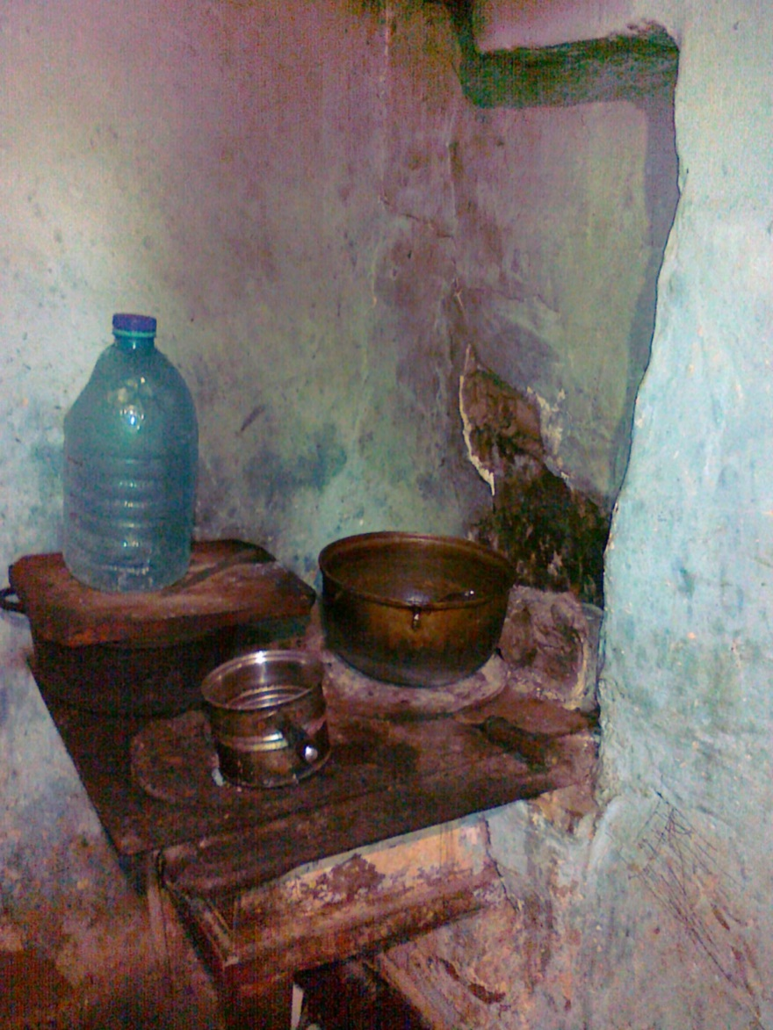
They cook on basic stoves which belch out smoke

Slide 5
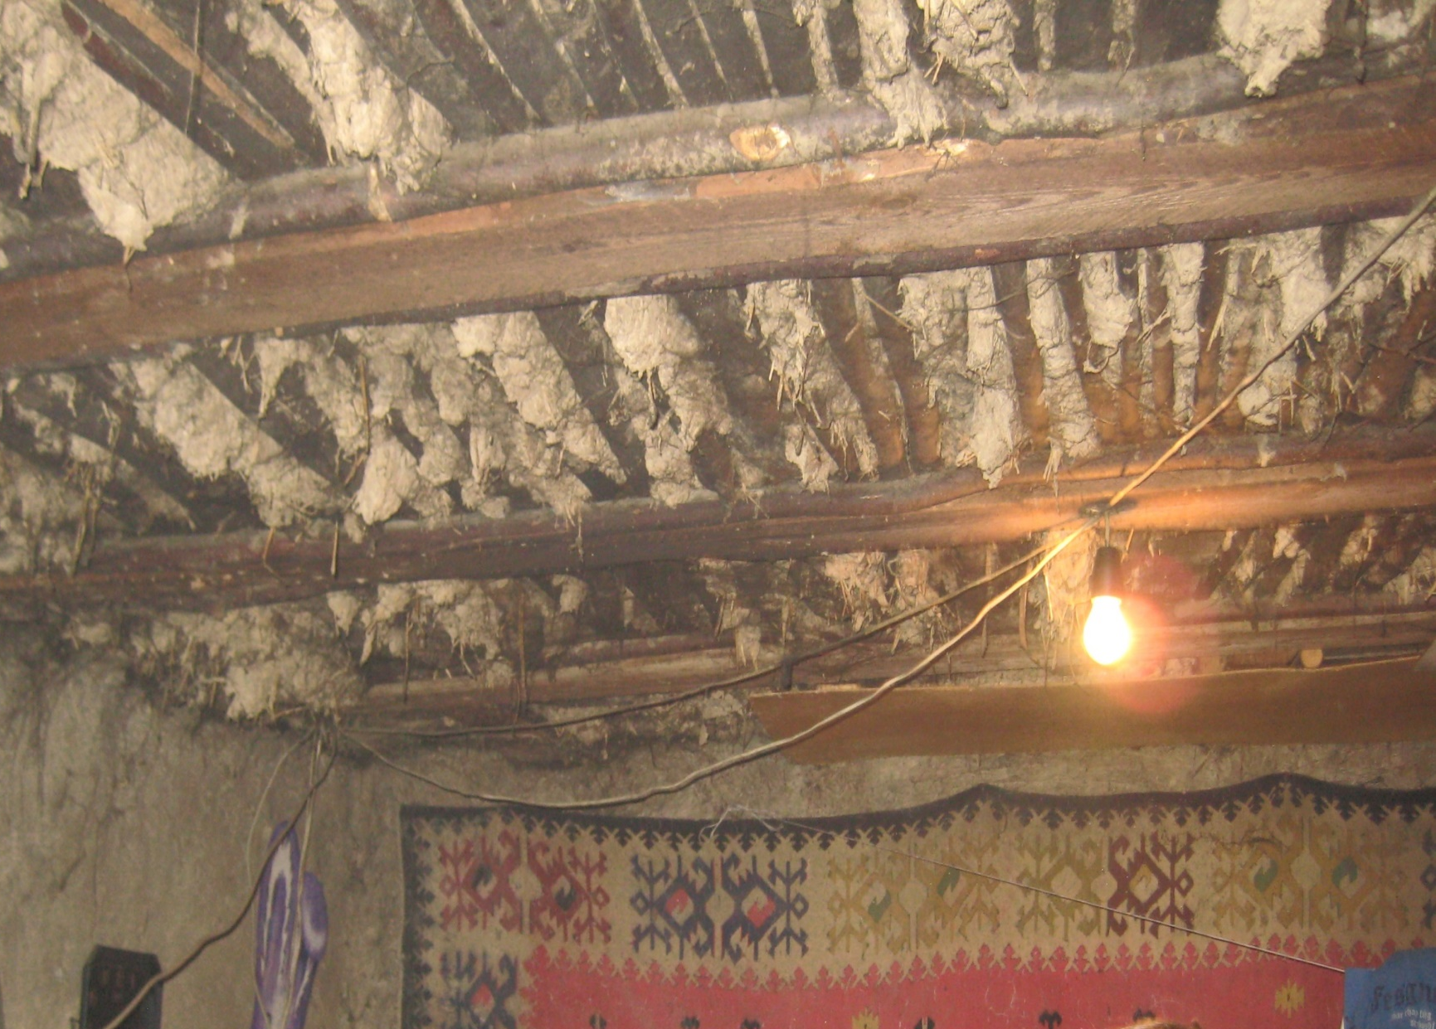
Live in badly built houses with roofs that leak

Slide 6
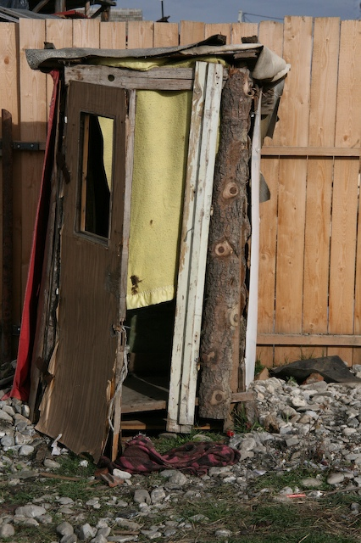
Toilets are outside and are a hole in a plank of wood

Slide 7
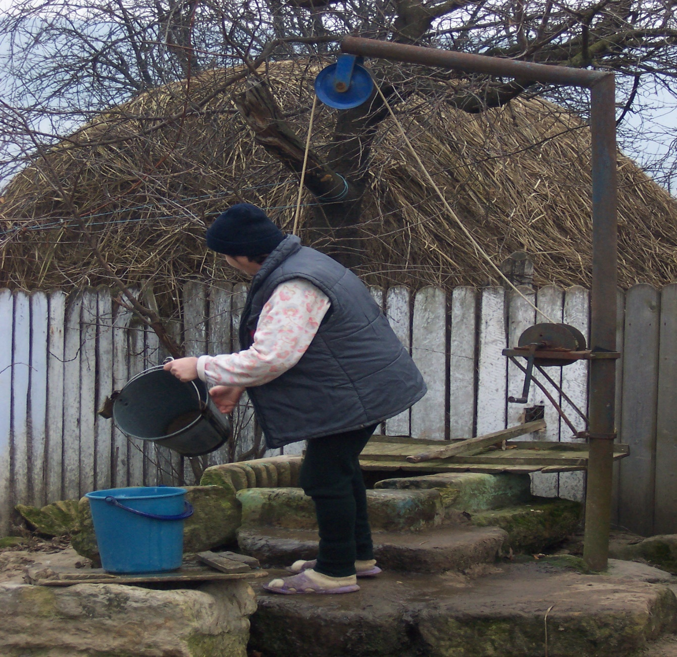
Many people have to fetch all their water from a well

Slide 8
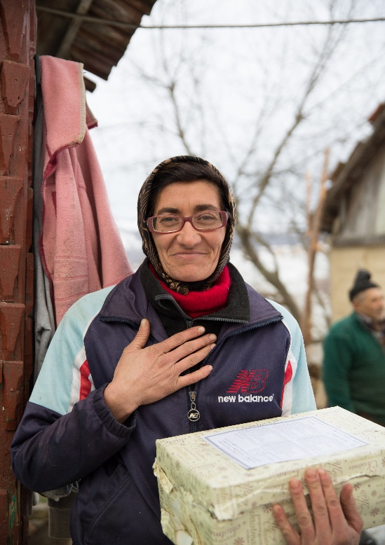
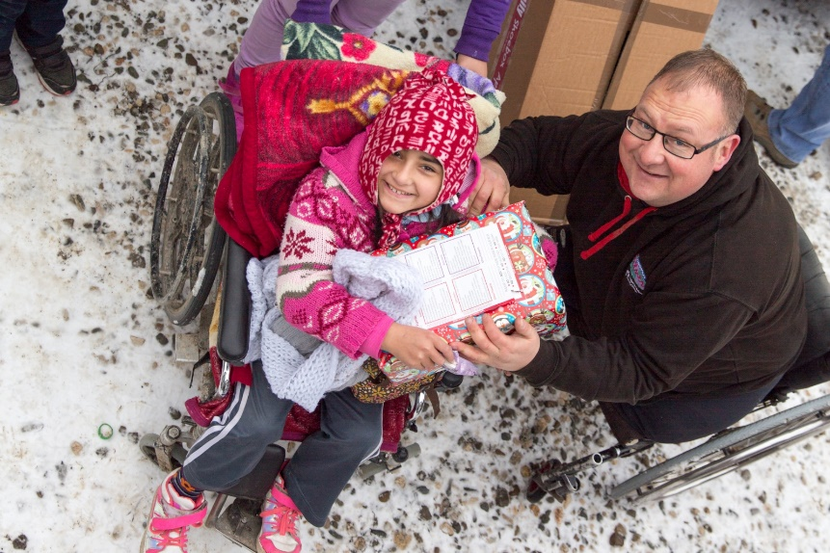
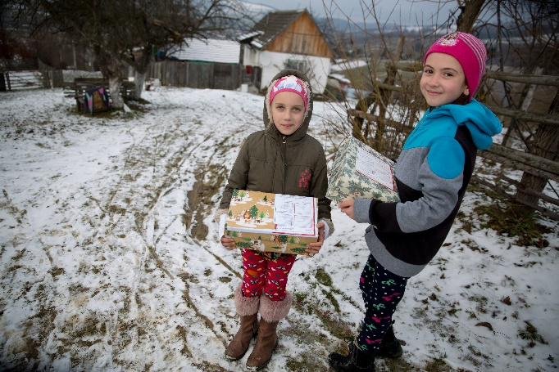
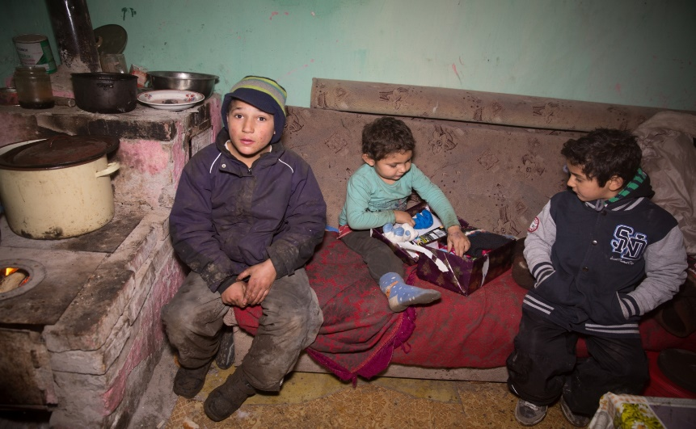
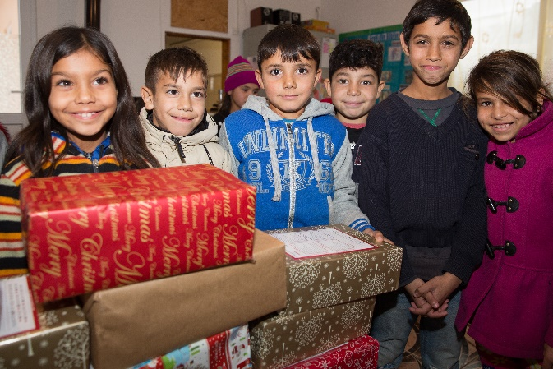
By filling a shoebox…..
You can bring happiness to peoples lives

